Slide 1
Chapter I
Introduction
Jehan-François Pâris
jfparis@uh.edu

Slide 2
Chapter Overview
Defining operating systems
Major functions of an OS
Types of operating systems
UNIX
Kernel organization

Slide 3


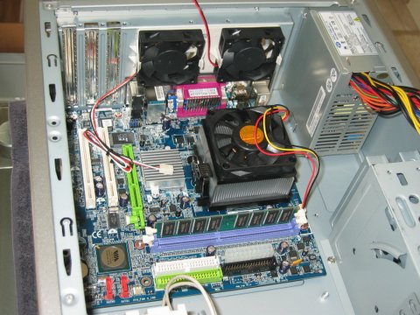
What is an operating system?
“What stands between the user and the bare machine”

Slide 4
What is an operating system?
The basic software required to operate a computer.
Similar role to that of the conductor of an orchestra

Slide 5
Do not belong to OS
All user programs
Compilers, spreadsheets, word processors, and so forth
Most utility programs
  mkdir is a user program calling mkdir()
The command language interpreter
  Anyone can write his/her UNIX shell

Slide 6
The UNIX shells
UNIX has several shells
  sh (the Bourne shell) is the original UNIX shell
  csh was developed at Berkeley by Bill Joy
  ksh (the Korn shell) was developed by David Korn at AT&T Bell Laboratories
  bash (the GNU Bourne-Again shell )
and the list is far from complete

Slide 7
The core of the OS
Part that stays in main memory
Controls the execution of all other programs.
Known as the kernel
  Also called monitor, supervisor, executive
Other programs interact with it through
system calls

Slide 8
System calls
Program
System call /
system request
Kernel

Slide 9
A question
Who among you has already used system calls?

Slide 10
The answer
All of you
  All I/O operations are performed through system calls

Slide 11
FUNCTIONS OF AN OS
Four basic functions
  To provide a better user interface
  To manage the system resources
  To protect users’ programs and data
  To let programs exchange information

Slide 12
A better user interface
Accessing directly the hardware would be very cumbersome
Must enter manually the code required to read into main memory each program
  boot strapping

Slide 13
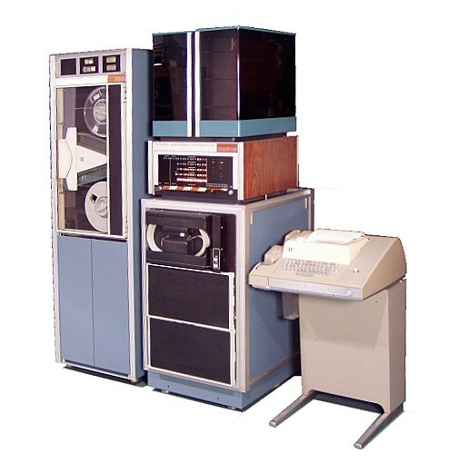
How it was done (I)
PDP 8
Early 70’s
12-bit machine

Slide 14
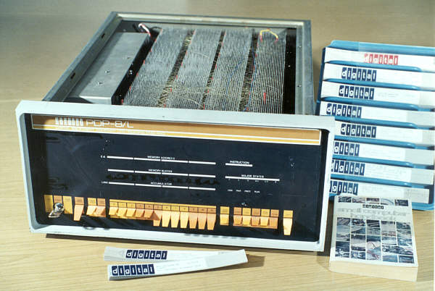
How it was done (II)
Toggle switches in front panel were used to enter the bootstrap code

Slide 15
Batch systems
Allow users to submit a batches of requests to be processed in sequence
Include a command language specifying what to do with the inputs
  Compile
  Link edit
  Execute and so forth

Slide 16
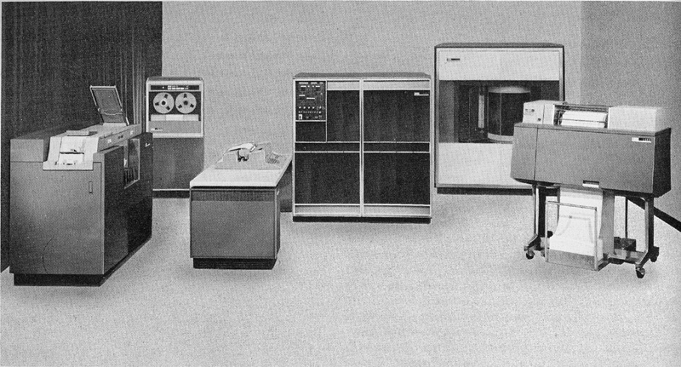
An IBM 1401

Slide 17
Interactive systems
Came later
Allow users to interact with the OS through their terminals:
Include an interactive command language
  UNIX shells, Windows PowerShell
  Can also be used to write scripts

Slide 18
Time sharing
Lets several interactive users to access a single computer at the same time
Standard solution when computers were expensive

Slide 19
Graphical user interfaces
Called GUIs (pronounced goo-eys):
Macintosh, Windows, X-Windows, Linux
Require a dedicated computer for each user
Pioneered at XEROX Palo Alto Research Center
Popularized by the Macintosh
Dominated the market with Microsoft Windows

Slide 20
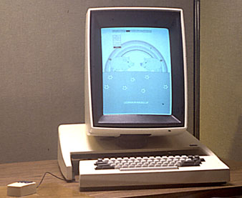
The Xerox Alto

Slide 21
Xerox PARC (I)
Founded by XEROX in 1970
Invented
  Laser printing
  Ethernet
  The GUI paradigm
  Object-oriented programming (Smalltalk)

Slide 22
Xerox PARC (II)
All their inventions were brought to market by other concerns
Popular belief is that Xerox management blew it
In reality
  Alto workstations were very expensive
  Smalltalk was very slow
  Group was too small to deliver a full system

Slide 23
The Tablet
Convergence of five trends
  Search for cheaper computing devices:
    OLPC, netbooks,
  Cheaper LCD displays
  Solid-State Storage (SSD)
  Ubiquitous wireless
  Convergence of smart phones and portable media players

Slide 24
History repeats itself
First successful devices introduced by Apple
  iPod, iPhone, iPad, …
    First iPad was underpowered
Competition soon grows
  Cheaper Android devices

Slide 25
With a difference!
Apple did not "steal" the concept from anyone
iPods, iPhones, iPads were an instant success
  Reasonably priced

Slide 26
Two models
Apple:
  Closed ecosystem
  (walled garden)
  Strict controls on app market
  Missing features
    No file system
Android:
  Just the opposite
  Lax controls on app market
  Can access the
  Linux/Android shell

Slide 27

Is this paradise?

Slide 28
Summary
Six major steps
  Bare bone machine
  Batch systems
  Timesharing
  Personal computer
  Personal computer with GUI
  Tablet

Slide 29
File systems
Let users create and delete files without having to worry about disk allocation
  Users lose the ability to specify how their files are stored on the disk
  Database designers prefer to bypass the file system
Some file systems tolerate disk failures (RAID)

Slide 30
Managing system resources
Focus of most of the remainder of the course
Not an easy task
  Enormous gap between CPU speeds and disk access times

Slide 31
The memory hierarchy (I)
Level | Device | Access Time
1 | Fastest registers (2 GHz CPU) | 0.5 ns
2 | Main memory | 10-70 ns
3 | Secondary storage (disk) | 7 ms
4 | Mass storage (CD-ROM library) | a few s

Slide 32
The memory hierarchy (II)
To make sense of these numbers, let us consider an analogy

Slide 33
Writing a paper (I)
Level | Resource | Access Time
1 | Open book on desk | 1 s
2 | Book on desk
3 | Book in library
4 | Book far away

Slide 34
Writing a paper (II)
Level | Resource | Access Time
1 | Open book on desk | 1 s
2 | Book on desk | 20-140 s
3 | Book in library
4 | Book far away

Slide 35
Writing a paper (III)
Level | Resource | Access Time
1 | Open book on desk | 1 s
2 | Book on desk | 20-140 s
3 | Book in library | 162 days
4 | Book far away

Slide 36
Writing a paper (IV)
Level | Resource | Access Time
1 | Open book on desk | 1 s
2 | Book on desk | 20-140 s
3 | Book in library | 162 days
4 | Book far away | 63 years

Slide 37
Will the problem go away?
It will become worse
  Disk access times are limited by rotational speed of disk drive
Our sole hope is the development of
new storage technologies
  Cheaper than main memory
  Faster than disk drives

Slide 38
What can be done?
Two main techniques
  Making disk accesses more efficient
  Doing something else while waiting for an I/O operation
Not very different from what we are doing in our every day's lives

Slide 39
Optimizing read accesses (I)
When we shop in a market that’s far away from our home, we plan ahead and buy food for several days
The OS will read as many bytes as it can during each disk access
  In practice, entire blocks (4KB or more)
  Blocks are stored in the I/O buffer

Slide 40
Optimizing read accesses (II)
Process
Read operation
I/O buffer
Physical I/O
Most small read operations can be completed without any disk access
Disk
Drive

Slide 41
Optimizing read accesses (III)
Buffered reads work quite well
  Most systems use it
They have a major limitation
  If we try to read too much ahead of the program, we could end bringing into main memory data that will never be used

Slide 42
Optimizing read accesses (IV)
Can also keep in a buffer recently accessed blocks hoping they will be accessed again
  Caching
Works very well because we keep accessing again and again the data we are working with
Caching is a fundamental technique of
OS and database design

Slide 43
Optimizing write accesses (II)
If we live far away from a library, we wait until we have several books to return before making the trip
The OS will delay writes for a few seconds then write an entire block
  Since most writes are sequential, most small writes will not require any disk access

Slide 44
Optimizing write accesses (II)
Delayed writes work quite well
  Most systems use it
It has a major drawback
  We will lose data if the system or the program crashes
    After the program issued a write but
    Before the data were saved to disk

Slide 45
Doing something else
When we order something on the web, we do not remain idle until the goods are delivered
The OS can implement multiprogramming and let the CPU run another program while a program waits for an I/O

Slide 46
Advantages (I)
Multiprogramming is very important in business applications
  Many of these applications use the peripherals much more than the CPU
  For a long time the CPU was the most expensive component of a computer
  Multiprogramming was invented to keep the CPU busy

Slide 47
Advantages (II)
Multiprogramming made time-sharing possible
Multiprogramming lets your PC run several applications at the same time
  MS Word and MS Outlook

Slide 48
Multiprogramming (I)
Multiprogramming lets the CPU divide its time among different tasks:
  One tenth of a second on a program, then another tenth of a second on another one and so forth
A single-core CPU is only working on one single task at any given time

Slide 49
Multiprogramming (II)
The CPU does not waste any time waiting for the completion of I/Os
From time to time, the OS will need to regain control of the CPU
  Because a task has exhausted its fair share of the CPU time
  Because something else needs to be done.
This is done through interrupts.

Slide 50
Interrupts (I)
Request to interrupt the flow of execution the CPU
Detected by the CPU hardware
  After it has executed the current instruction
  Before it starts the next instruction.

Slide 51
A very schematic view (I)
A very basic CPU would execute the following loop:
    forever {
    fetch_instruction();
    decode_instruction();
    execute_instruction();
    }
Pipelining makes things more complicated

Slide 52
A very schematic view (II)
We add an extra step:
    forever {
    check_for_interrupts();
    fetch_instruction();
    decode_instruction();
    execute_instruction();
    }

Slide 53
Interrupts (II)
When an interrupt occurs:
  The current state of the CPU (program counter, program status word, contents of registers, and so forth) is saved, normally on the top of a stack
  A new CPU state is fetched

Slide 54
Interrupts (III)
New state includes a new hardware-defined value for the program counter
  Cannot “hijack” interrupts
Process is totally transparent to the task being interrupted
  A process never knows whether it has been interrupted or not

Slide 55
Types of interrupts (I)
I/O completion interrupts
  Notify the OS that an I/O operation has completed,
Timer interrupts
  Notify the OS that a task has exceeded its quantum of CPU time,

Slide 56
Types of interrupts (II)
Traps
  Notify the OS of a program error (division by zero, illegal op code, illegal operand address, ...) or a hardware failure
System calls
  Notify OS that the running task wants to submit a request to the OS

Slide 57
A surprising discovery
Programs do interrupt themselves!

Slide 58
Context switches
Each interrupt will result into
two context switches:
  One when the running task is interrupted
  Another when it regains the CPU
Context switches are not cheap
The overhead of any simple system call is
two context switches
Remember that!

Slide 59
Prioritizing interrupts (I)
Interrupt requests may occur while the system is processing another interrupt
All interrupts are not equally urgent (as it is also in real life
  Some are more urgent than other
  Also true in real life

Slide 60
Prioritizing interrupts (II)
The best solution is to prioritize interrupts and assign to each source of interrupts a priority level
  New interrupt requests will be allowed to interrupt lower-priority interrupts but will have to wait for the completion of all other interrupts
Solution is known as vectorized interrupts.

Slide 61
Example from real life
Let us try to prioritize
  Phone is ringing
  Washer signals end of cycle
  Dark smoke is coming out of the kitchen
  …
With vectorized interrupts, a phone call will never interrupt another phone call

Slide 62
The solution
Smoke in the kitchen
Phone is ringing
End of washer cycle
More low-priority stuff

Slide 63
Disabling Interrupts
We can disable interrupts
OS does it before performing short critical tasks that cannot be interrupted
  Works only for single-threaded kernels
User tasks should be prevented from doing it
  Too dangerous

Slide 64
DMA
Disk I/O poses a special problem
  CPU might have to transfer large quantities of data between the disk controller's buffer and the main memory
Direct memory access (DMA) allows the disk controller to read data from and write data to main memory without any CPU intervention
  Controller “steals” memory cycles from CPU

Slide 65
Protecting users’ data (I)
Unless we have an isolated single-user system, we must prevent users from
  Accessing
  Deleting
  Modifying
without authorization other people's programs and data

Slide 66
Protecting users’ data (III)
Two aspects
  Protecting user's files on disk
  Preventing programs from interfering with each other

Slide 67
Historical Considerations
Earlier operating systems for personal computers did not have any protection
  They were single-user machines
  They typically ran one program at a time
Windows 2000, Windows XP, Vista and MacOS X are protected

Slide 68
Protecting users’ files
Key idea is to prevent users’ programs from directly accessing the disk
Will require I/O operations to be performed by the kernel
Make them privileged instructions that only the kernel can execute

Slide 69
Privileged instructions
Require a dual-mode CPU
Two CPU modes
  Privileged mode or executive mode that allows CPU to execute all instructions
  User mode that allows CPU to execute only safe unprivileged instructions
State of CPU is determined by a special bit

Slide 70
User Process
Kernel
X

Slide 71
Switching between states
User mode will be the default mode for all programs
  Only the kernel can run in supervisor mode
Switching from user mode to supervisor mode is done through an interrupt
  Safe because the jump address is at a well-defined location in main memory

Slide 72
Performing an I/O
I/O request
(interrupt)
Program
Kernel
Physical I/O
(executed by the kernel)

Slide 73
An analogy (I)
Most UH libraries are open stacks
  Anyone can consult books in the stacks and bring them to checkout
National libraries and the Library of Congress have close stack collections
  Users fill a request for a specific document
  A librarian will bring the document to the circulation desk

Slide 74
An analogy (II)
Open stack collections
  Let users browse the collections
  Users can misplace or vandalize books
Close stack collections
  Much slower and less flexible
  Much safer

Slide 75
More trouble
Having a dual-mode CPU is not enough to protect user’s files
Must also prevent rogue users from tampering with the kernel
  Same as a rogue customer bribing a librarian in order to steal books
Done through memory protection

Slide 76
Memory protection (I)
Prevents programs from accessing any memory location outside their own address space
Requires special memory protection hardware
  Memory Management Unit (MMU)
Memory protection hardware
  Checks every reference issued by program
  Generates an interrupt when it detects a protection violation

Slide 77
Memory protection (II)
Has additional advantages:
  Prevents programs from corrupting address spaces of other programs
  Prevents programs from crashing the kernel
    Not true for device drivers which are inside the kernel
Required part of any multiprogramming system

Slide 78
Memory protection (III)
CPU
MAR
memory address
MMU
checks all
memory references
MMU
Main memory

Slide 79
Even more trouble
Having both a dual-mode CPU and memory protection is not enough to protect user’s files
Must also prevent rogue users from booting the system with a doctored kernel
  Example:
    Can run Linux from a “live” CD Linux
    Linux will read all NTFS files ignoring all restrictions set up by XP or Vista

Slide 80
INTERPROCESS COMMUNICATION
Has become very important over the last thirty years
Two techniques
  Message passing
    General but not very easy to use
  Shared memory
    Less general, easier to use but requires
    interprocess synchronization

Slide 81
ANOTHER VIEW
Arpaci-Dusseau & Arpaci-Dusseau
Focusses on services provided by OSes
Three themes
  Virtualization
  Concurrency
  Persistence

Slide 82
Virtualization
The process abstraction
Virtualizing the CPU:
  Process scheduling
Virtualizing the memory:
  Memory management

Slide 83
Concurrency
Threads
Locks
Semaphores
We will cover threads in the chapter on
processes because they are essential
to the clienst server model

Slide 84
Persistence
The file system

Slide 85
TYPES OF OPERATING SYSTEMS
Already discussed:
  Batch systems
  Time-Sharing systems
Will now introduce
  Real-Time systems
  Operating systems for multiprocessors
  Distributed systems

Slide 86
Real-Time Systems
Designed for applications with strict real-time constraints :
  process control
  guidance systems
  most multimedia applications
Must guarantee that critical tasks will always be performed within a specific time frame.

Slide 87
Hard RT Systems
Hard real-time systems
  Must guarantee that all deadlines will always be met
  Any failure could have catastrophic consequences:
    The reactor could overheat and explode
    The rocket could be lost

Slide 88
Soft RT Systems
Soft real-time systems
  Guarantee that most deadlines will be met
  A DVD decoder that miss a deadline will spoil our viewing pleasure for a fraction of a second

Slide 89
Observations
Hard RT applications normally run on special RT OSes
Soft RT applications can run on a regular OS if the OS supports them
Interactive and time-sharing systems are not
RT systems
  They attempt to provide a fast response time but do not try to meet specific deadlines

Slide 90
Multiprocessor operating systems
CPU
CPU
CPU
CPU
CACHE
CACHE
CACHE
CACHE
MEMORY
Designed for multiprocessor architectures
  Several processors share the same memory

Slide 91
Master/Slave Multiprocessing
Single copy of OS runs on a dedicated processor
Other processors can only run applications
Major advantage is simplicity
  Requires few changes
Major disadvantage is lack of scalability
  Single copy of OS can become a bottleneck

Slide 92
Symmetric Multiprocessing
Any processor can perform all functions
  There can be multiple copies of the OS running in parallel
Must prevent them from interfering with each other
  Disabling interrupts will not work
  Must add locks to all critical sections

Slide 93
The future
Most computers now have and will have
multicore CPUs
  Sole practical way to increase CPU power
Using multicore architectures in an effective way is a huge challenge

Slide 94
Distributed Systems
Integrated networks of computers
  Workstations sharing common resources (file servers, printers, …)
Current trend is to leave systems very loosely coupled
  Each computer has its own OS

Slide 95
Client /Server Model
Servers wait for requests from clients and process them
  File servers
  Print servers
  Authentication servers
CLIENT
request
SERVER
reply

Slide 96
A typical server
for (;;){
//wait for request
get_request(…);
// process it
process_request(…);
// send reply
send_reply(…);
} // forever

Slide 97
Network File System
SERVER
Lets several workstations share files
stored on a file server

Slide 98
Performance Issues
Response time is the main issue
  Network latency is now added to disk latency
Will attempt to mask these two latencies through intensive client caching
  Works very well

Slide 99
File Consistency Issues (I)
SERVER
What happens if a file F is simultaneously modified on two distinct workstations
F

Slide 100
File Consistency Issues (II)
SERVER
F’
F’’
Client caches will hold different versions F’ and F’’ of file F
F

Slide 101
File Consistency Issues (III)
Maintaining file consistency is a very important issue in distributed/networked file system design
Different systems use different approaches
  NFS from Sun Microsystems
  AFS/Coda from CMU
  …

Slide 102
Other distributed systems issues
Authenticating users
  A problem on insecure networks
Making distributed systems as reliable as stand-alone systems.
Keeping the clocks of the machines more or less synchronized.

Slide 103
UNIX (I)
Started at Bell Labs in the early 70's as an attempt to build a sophisticated time-sharing system on a very small minicomputer.
First OS to be almost entirely written in C
Ported to the VAX architecture in the late 70’s at U. C. Berkeley:
  Added virtual memory and networking

Slide 104
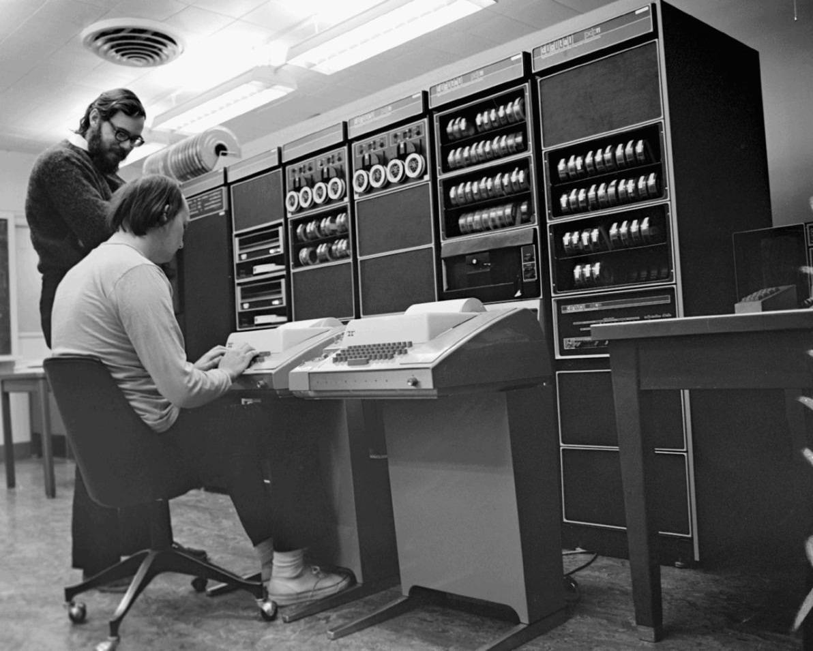
The fathers of UNIX
Ken Thompson and Denis Ritchie

Slide 105
UNIX (II)
Became the standard operating systems for workstations
  Selected by Sun Microsystems
Became less popular because
  Two many variants
    Berkeley BSD, ATT System V, …
  PCs displaced workstations
  Windows has a better user interface

Slide 106
UNIX Today
Several free versions exist (FreeBSD, Linux):
  Free access to source code
    Ideal platform for OS research
Apple OS X runs on the top of an updated version of BSD
Android runs on top of a heavily customized Linux kernel
Chrome runs on top of a vanilla Linux

Slide 107
A Rapid Tour
UNIX kernel is the core of the system and handles the system calls
UNIX has several shells: sh, csh, ksh, bash
On-line command manual:
  man xyz
  displays manual page for command xyz
  man 2 xyz
  displays manual page for system call xyz(…)

Slide 108
Most Lasting Impact
First OS that could
  Run efficiently on very different platforms
  Had its source code made available to its users
  File system inspired most more recent OSes
Remains the best platform for OS research

Slide 109
KERNEL ORGANIZATIONS
Three basic organizations:
  Monolithic kernels:
    The default
  Layered kernels:
    Another great idea that did not work
  Microkernels:
    Hurt by the high cost of context switches

Slide 110
Monolithic kernels
No particular organization
  All kernel functions share the same address space
  This includes devices drivers and other kernel extensions
Lack of internal organization makes the kernel
hard to manage, extend and debug

Slide 111
MSDOS (I)
Resident System Program
MS-DOS Device Drivers
BIOS Device Drivers

Slide 112
The BIOS
Basic Input-Output System
Stored on a chip
  First ROM, now EEPROM
Takes control of CPU when system is turned on
  Identifies system components
  Initiates booting of operating system
Also provides low-level I/O access routines

Slide 113
The “curse”
Hardware lacked dual mode and hardware memory protection
  Nothing prevented application programs from accessing directly the BIOS
  Program accessing disk files through BIOS I/O routines assumed a given disk organization
    Changing it became impossible

Slide 114
The solution
For a long time, Microsoft could not make radical changes to its FAT-16 disk organization
Windows XP and all modern operating systems prevent user programs from bypassing the kernel.

Slide 115
UNIX
Monolithic kernel
Terminal, device and memory controllers
Monolithic kernel contains everything that is
not device-specific including file system, networking code, and so forth.

Slide 116
Layered kernel
Proposed by Edsger Dijkstra
Implemented as a hierarchy of layers:
Each layer defines a new data object
  Hiding from the higher layers some functions of the lower layers
  Providing some new functionality

Slide 117
THE operating system kernel
(named after Dutch initials of T. U. Eindhoven)
User programs
Buffering for I/O devices
Operator console device driver
Memory management
CPU scheduling
Hardware

Slide 118
Limitations
Layered design works extremely well for networking code
  Each layer offers its own functionality
Much less successful for kernel design
  No clear ordering of layers
    Memory management uses file system features and vice versa

Slide 119
Microkernels
A reaction against “bloated” monolithic kernels
  Hard to manage, extend, debug and secure
Key idea is making kernel smaller by delegating non-essential tasks to
trusted user-level servers
  Same idea as subcontracting
Microkernel keeps doing what cannot be delegated

Slide 120
How it works (I)
User program
Trusted server
Small
microkernel

Slide 121
How it works (II)
Microkernel
  Receives request from user program
  Decides to forward it to a user-level server
  Waits for reply for server
  Forwards it to user program
Trusted server runs outside the kernel
  Cannot execute privileged instructions

Slide 122
Advantages
Kernel is smaller, easier to secure and manage
Servers run outside of the kernel
  Cannot crash the kernel
  Much easier to extend kernel functionality by adding new servers
    Adding an NTFS server to UNIX microkernel

Slide 123
Major disadvantage
Too slow
  Four context switches instead of two
Speed remains an essential concern
We don’t like to trade speed for safety (or anything else)

Slide 124
A conventional kernel
User program
Each system call occasions
two context switches
Each system call occasions
two context switches
Conventional kernel

Slide 125
A microkernel
User program
Trusted server
Four context switches
Small
Microkernel

Slide 126
Mach
Designed in mid 80’s to replace UNIX kernel
New kernel with different system calls
  UNIX system calls are routed to an
  emulation server
Emulation server was supposed to run in user space
  Ended inside the kernel

Slide 127
MINIX 3
MINIX 1 was designed for teaching OS internals
  Predates Linux
Now aimed at high reliability (embedded) applications
  More willing to trade space for reliability
Runs on x86 and ARM processors
Compatible with NetBSD

Slide 128
MINIX 3 MICROKERNEL
"Tiny" (12,700 lines) microkernel
  Handles interrupts and message passing
  Only code running in kernel mode
Other OS functions are handled by
isolated, protected, user-mode processes
  Each device driver is a separate user-mode process
  System automatically restarts crashed drivers

Slide 129
Modular kernels
Linux, Windows
Modules are object files whose contents can be linked to—and unlinked from—the kernel at any time
  Run inside the kernel address space
  Used to add to the kernel device drivers for new devices

Slide 130
Advantages
Extensibility:
  Can add new features the kernel
  In many cases, the process is completely transparent to the user
Lack of performance penalty:
  Modules run in the kernel address space

Slide 131
Disadvantage
Lower reliability
  A bad module can corrupt the whole kernel and crash the system.
Serious problem
  Many device drivers are poorly written
  Device drivers account for 85% of reported failures of Windows XP

Slide 132
Current state of the art
UNIX
safe
fast
Mach
Windows
extensible

Slide 133
Why?
Unix has a monolithic kernel (which makes it fast) and does not allow extensions (which makes it both safe and non extensible)
Windows has a monolithic kernel (which makes it fast) and allows extensions (which makes it both extensible and unsafe)
Mach allows extensions in user space (which makes it extensible, safe and slow)

